Slide 1






Lecture 29:
Fetching Data with useEffect
Course - Web Development - II
-By
Instructor Name
welcome@krmangalam.edu.in
Sohna Road,Gurugram,Haryana 122103

Slide 2

| Table of Contents
Fetching Data with Fetch API and Axios.
Handling API Errors and Loading States.
References.
The End.

Slide 3

|
If your app is like a food delivery service (Zomato/Swiggy), how would you fetch the list of restaurants from the server?

Slide 4
|
If your app is like a food delivery service (Zomato/Swiggy), how would you fetch the list of restaurants from the server?
The restaurant data is stored in a database on the server. When the React app needs this list, it makes an API call to the server. The server then returns the data as a JSON response, which React receives and displays on the screen.
In React, we can make this API call in two common ways:
Using fetch – a built-in JavaScript function to request and receive data.
Using axios – a popular third-party library that makes API calls simpler and more powerful.

Slide 5
| Fetch API
The Fetch API is a built-in JavaScript feature that allows us to make HTTP requests (like GET, POST, PUT, DELETE) to servers and get data back — usually in JSON format.
Key Points:
No need to install anything (already part of modern browsers).
Works with Promises (so we use .then() or async/await).
Commonly used in React to get or send data to a backend.
Example usage: fetching weather details, restaurant lists, user info, etc.

Slide 6
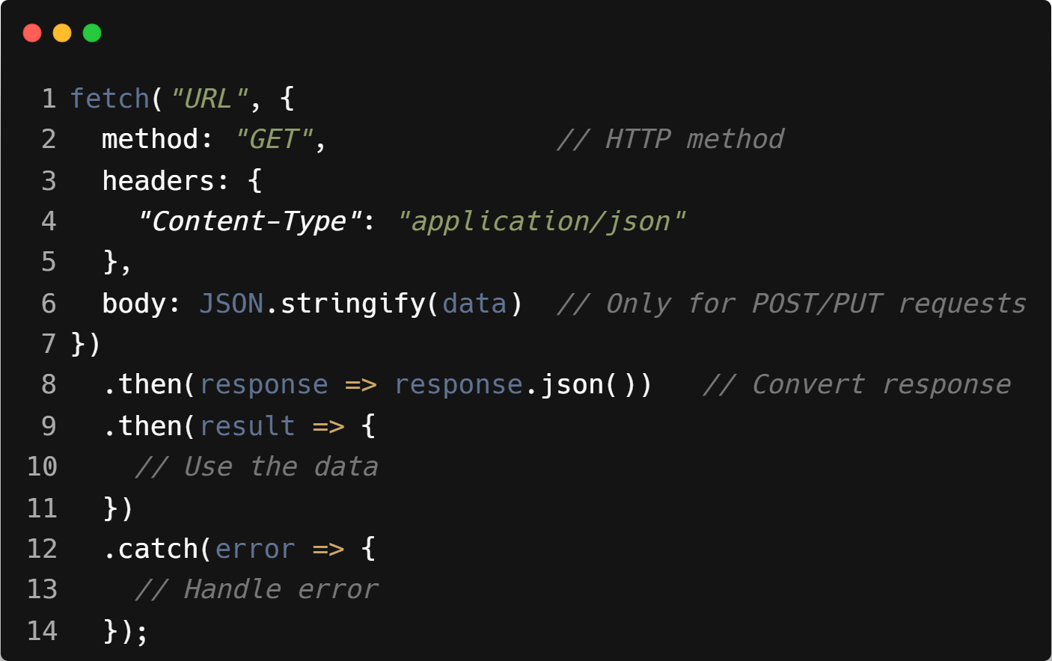
| Syntax : Fetch API

Slide 7

| Syntax Explanation : Fetch API
fetch is the function we use to call an API.
"URL" is the API endpoint (like https://api.example.com/restaurants).
{ ... } is an options object where we configure the request.

Slide 8
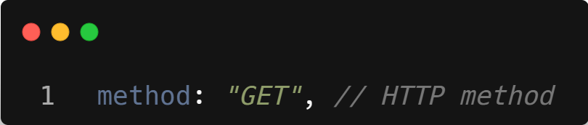
| Syntax Explanation : Fetch API
method defines the type of request:
GET → retrieve data (e.g., list of restaurants)
POST → send new data (e.g., add a new order)
PUT/PATCH → update existing data (e.g., update a profile)
DELETE → remove data (e.g., cancel an order)

Slide 9
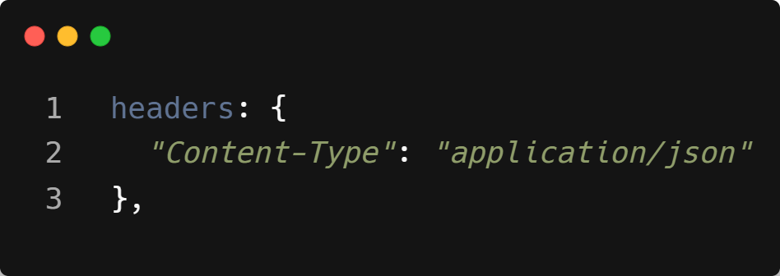
| Syntax Explanation : Fetch API
headers give extra information to the server.
"Content-Type": "application/json" means we are sending/expecting data in JSON format.

Slide 10
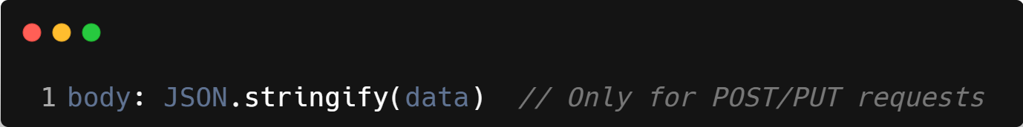
| Syntax Explanation : Fetch API
body is the actual data we send to the server.
JSON.stringify(data) converts a JavaScript object into a JSON string.
Used only with methods like POST or PUT, not with GET.

Slide 11
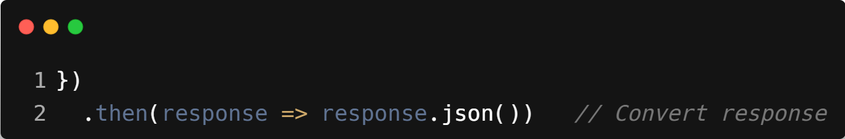
| Syntax Explanation : Fetch API
response is what the server sends back. .json() converts it into a usable JavaScript object.

Slide 12
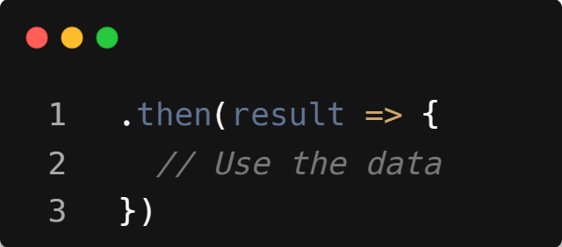
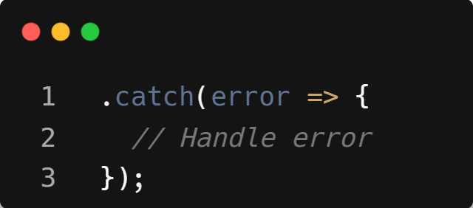
| Syntax Explanation : Fetch API
Here we get the final result (the actual data) and can use it in our app (like showing the list of restaurants).
.catch is used to handle errors (like if the server is down, wrong URL, or no internet).

Slide 13
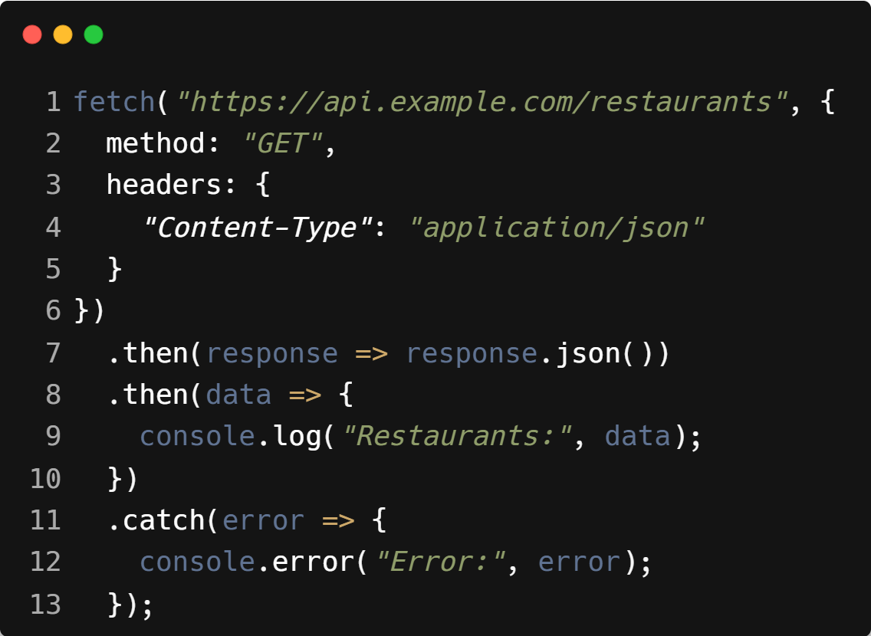
| Example : Fetch API

Slide 14
| Axios
Axios is a popular third-party library used in JavaScript/React to make HTTP requests (GET, POST, PUT, DELETE). It makes working with APIs easier compared to Fetch.
Key Points:
Not built-in → you install it with npm install axios.
Automatically converts responses to JSON (no need for response.json()).
Cleaner error handling (gives status codes, error messages directly).
Allows base URLs & default headers → no need to repeat the same URL or headers again and again.
Supports request cancellation and timeout handling.

Slide 15
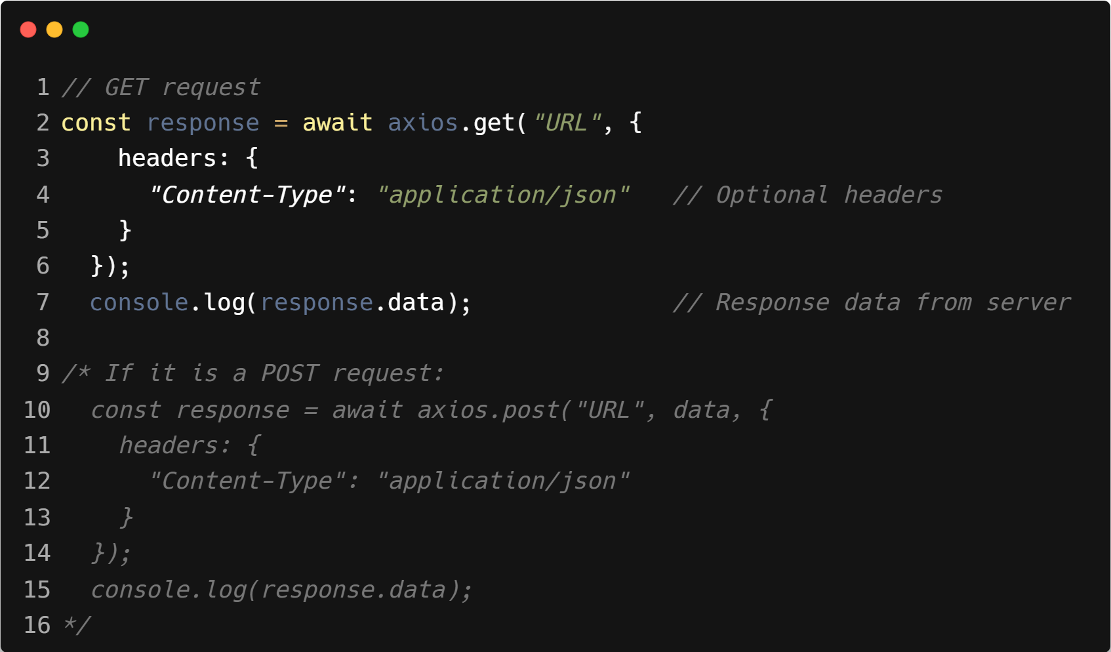
| Syntax : Axios

Slide 16
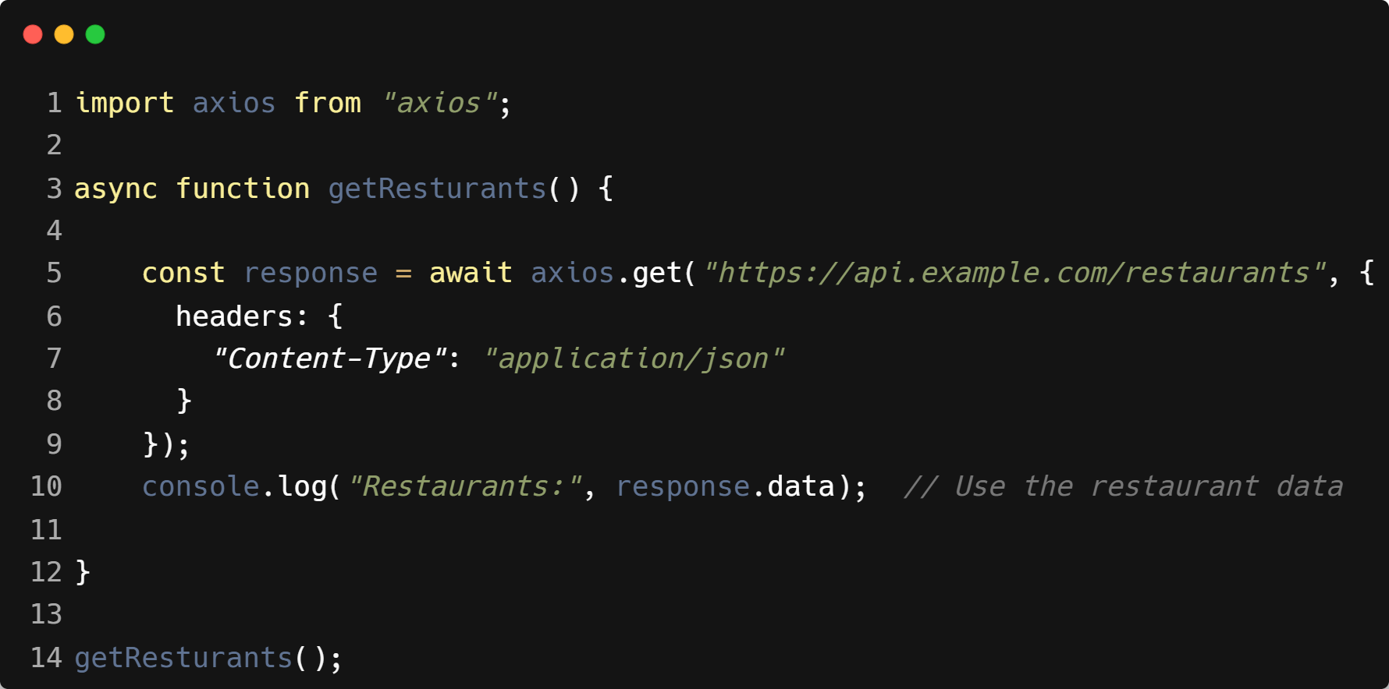
| Example : Axios

Slide 17
| Why Axios over Fetch API
Automatic JSON Conversion
Fetch → You must call response.json() manually.
Axios → Response data is ready in response.data.
Better Error Handling
Fetch → Only rejects on network errors (not 404 or 500).
Axios → Rejects for both network & HTTP errors (easier to handle).

Slide 18
| Why Axios over Fetch API
Shorter & Cleaner Syntax
Fetch needs more code for headers, data, and JSON conversion.
Axios is simpler: axios.get(url) or axios.post(url, data).
Supports Request Cancellation & Timeout
Axios → Can cancel requests or set timeouts easily.
Fetch → Needs extra AbortController for cancellation.

Slide 19
| Why Axios over Fetch API
Default Configuration
Axios allows setting a base URL and default headers, so you don’t repeat them in every request.
Fetch has no built-in support for this.

Slide 20

|
What if you order pizza 🍕 but the restaurant is closed — do you keep waiting forever, or does the app show “Restaurant unavailable”?

Slide 21
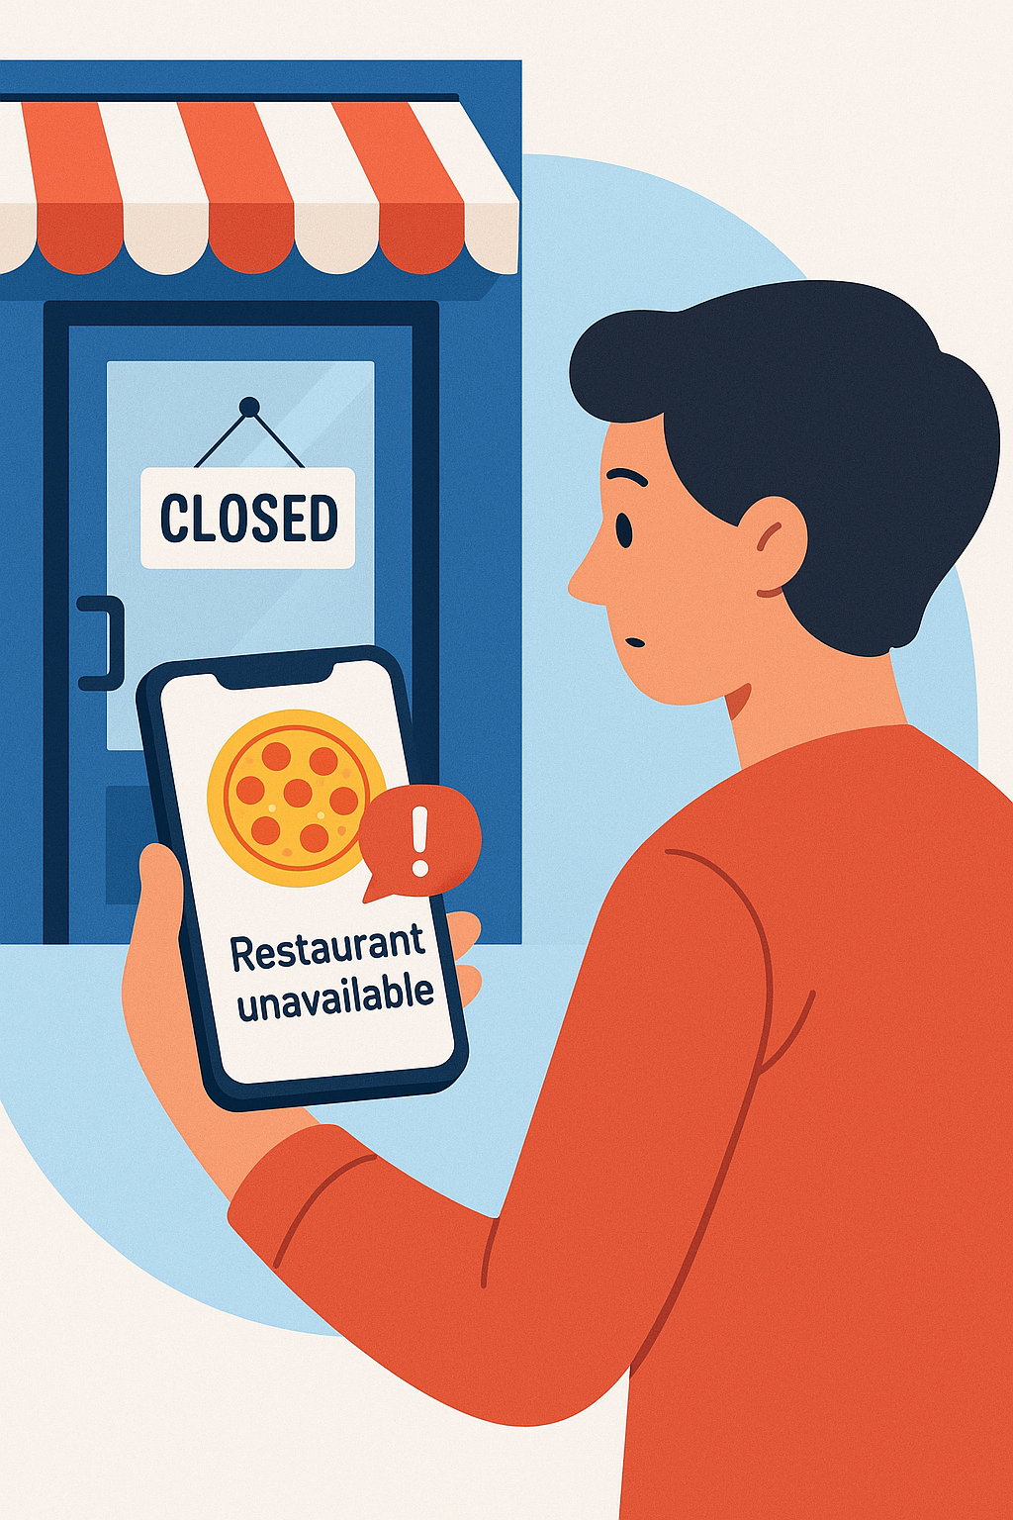
|
What if you order pizza 🍕 but the restaurant is closed — do you keep waiting forever, or does the app show “Restaurant unavailable”?
You don’t keep waiting — the app shows an error message like “Restaurant unavailable”.
Similarly, in React, if an API request fails, we should handle the error and show a clear message to the user instead of leaving them stuck with a blank screen or endless loading.

Slide 22
| Handling API Errors
When an API call fails (because of network issues, wrong URL, server down, or invalid data), we must catch the error and inform the user instead of showing a blank screen.
Why Important?
Prevents the app from crashing.
Improves user experience (clear messages instead of confusion).
Helps in debugging (we know what went wrong).

Slide 23
| Handling API Errors
How to Handle in React :
Use try/catch (with async/await) or .catch() (with promises).
Show a user-friendly message (e.g., “Something went wrong. Please try again.”).
Optionally log detailed errors in the console for developers.

Slide 24
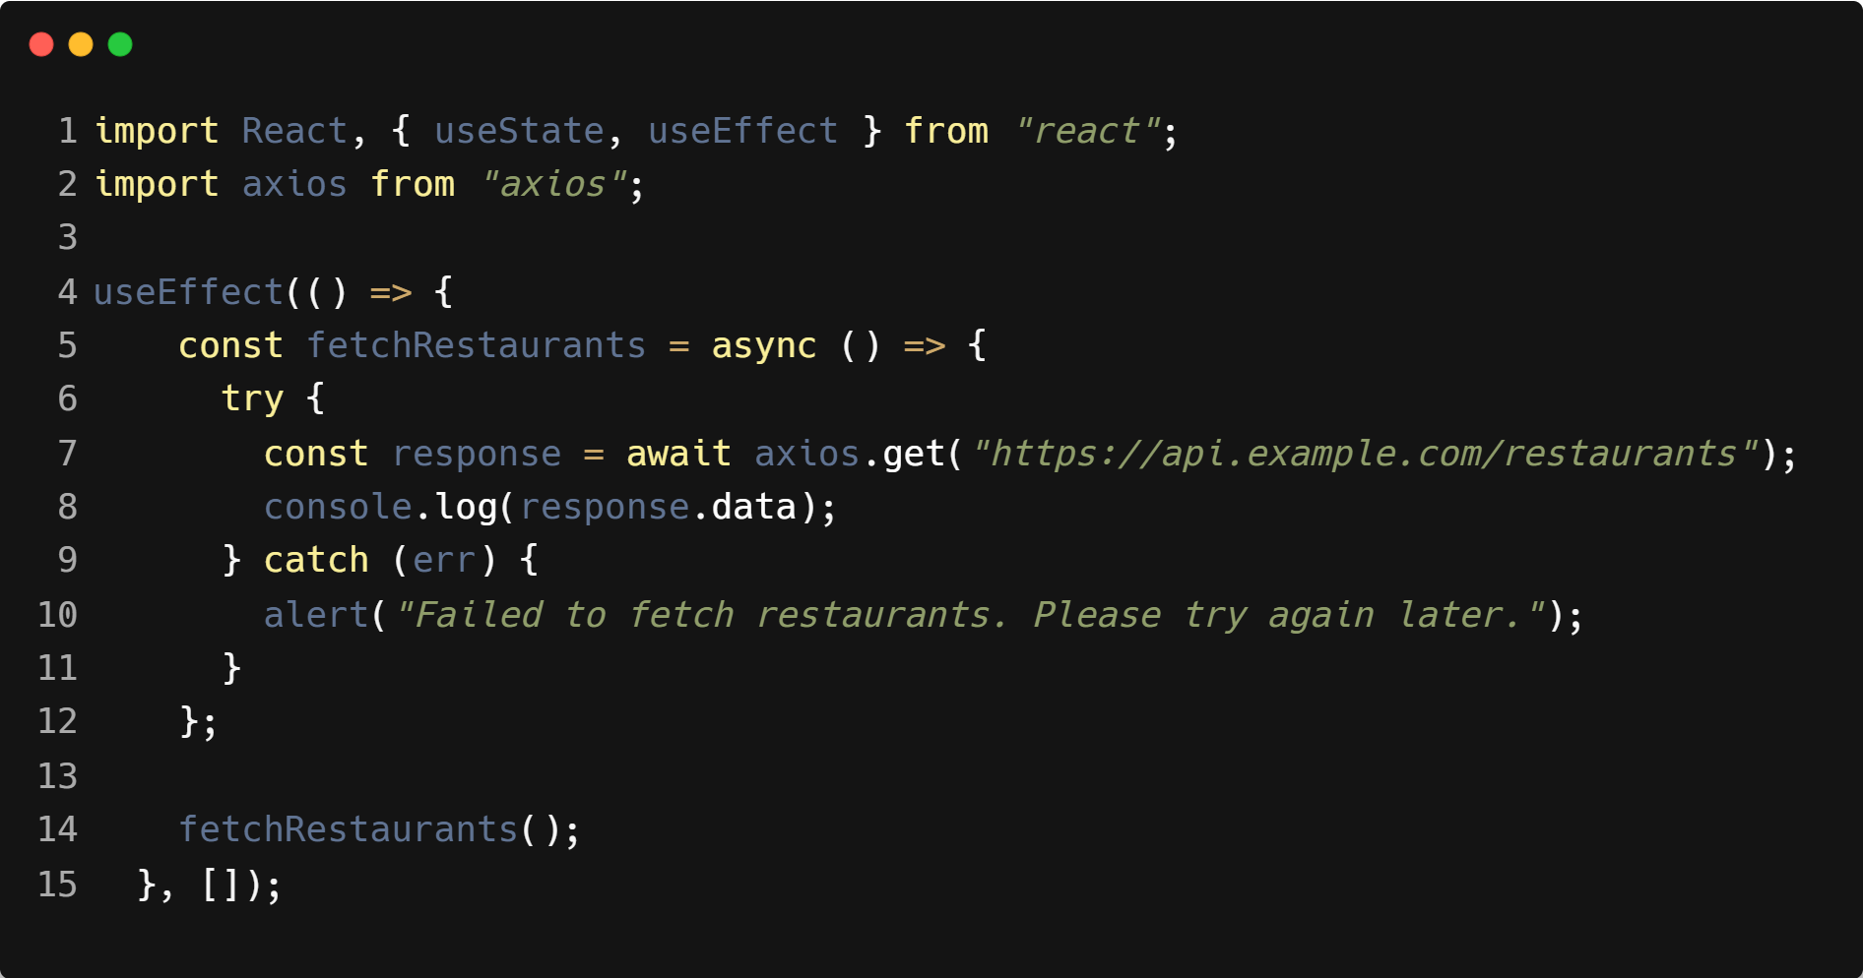
| Example : Handling API Errors

Slide 25

|
What happens on a food delivery app while you’re waiting for the restaurant to confirm your order?

Slide 26
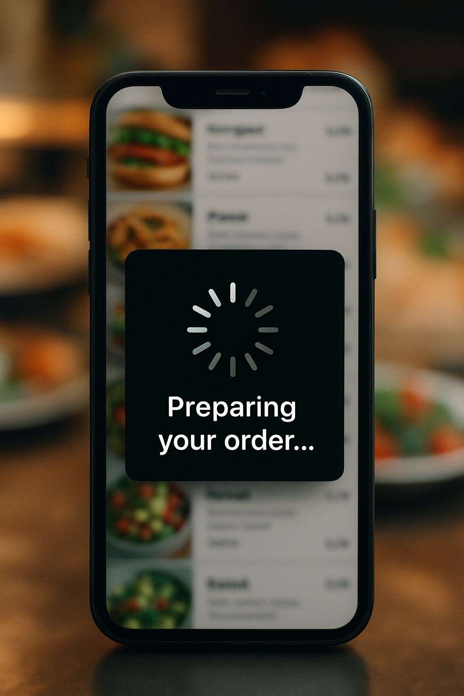
|
What happens on a food delivery app while you’re waiting for the restaurant to confirm your order?
The app shows a spinner or message like “Preparing your order…” so you know something is happening, instead of leaving you on a blank screen.
Similarly, in React, this represents the loading state while waiting for data from an API.

Slide 27
| Loading States
A loading state is a temporary UI shown while an application is waiting for data or a response from the server.
It helps keep users informed that something is happening in the background (e.g., spinner, progress bar, or “Loading…” message) instead of showing a blank screen.
Importance :
Keeps Users Informed – Shows that the app is working (not frozen).
Improves User Experience – A spinner/message is better than a blank screen.
Manages Expectations – Tells users “your data is coming soon.”
Prevents Frustration – Users won’t think the app is broken.
Professional Look – Every real-world app (Zomato, Swiggy, Netflix) uses loading indicators.

Slide 28
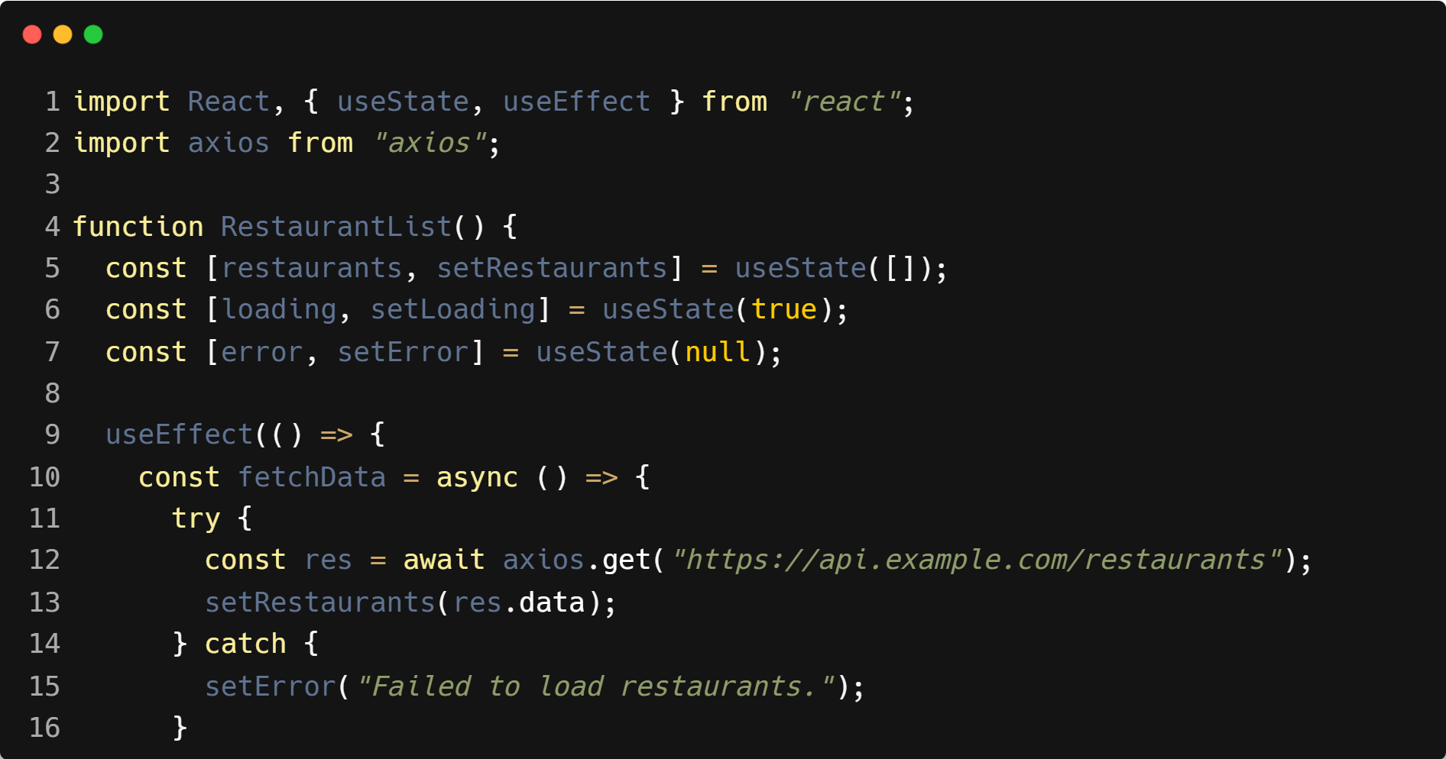
| Example : Loading States

Slide 29
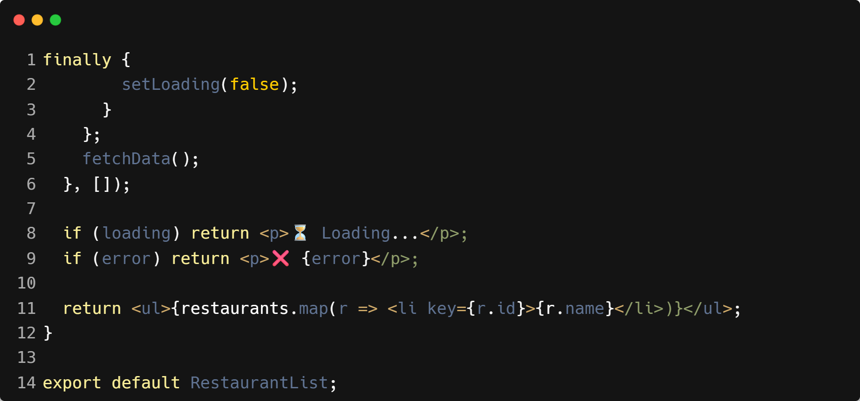
| Example : Loading States

Slide 30

|
When you’re typing in a search bar and you haven’t finished typing the word, should Google start searching after every single letter, or wait until you pause for a moment?

Slide 31

|
When you’re typing in a search bar and you haven’t finished typing the word, should Google start searching after every single letter, or wait until you pause for a moment?
It should wait until you pause for a moment. If Google searched after every letter, it would waste resources and overload the system. Instead, it waits until you stop typing briefly before making the request.
This is exactly what debouncing does in programming — it ensures the action (like an API call) only happens after the user has paused typing, not on every keystroke.

Slide 32

| Coding Questions
1. Fetching Data with Axios
Task :
Install Axios in your project: npm install axios.
Create a UserProfile component.
Use useEffect and axios.get() to fetch a single user's data from https://jsonplaceholder.typicode.com/users/1.
Store the user data in state and display the user's name and email.

Slide 33
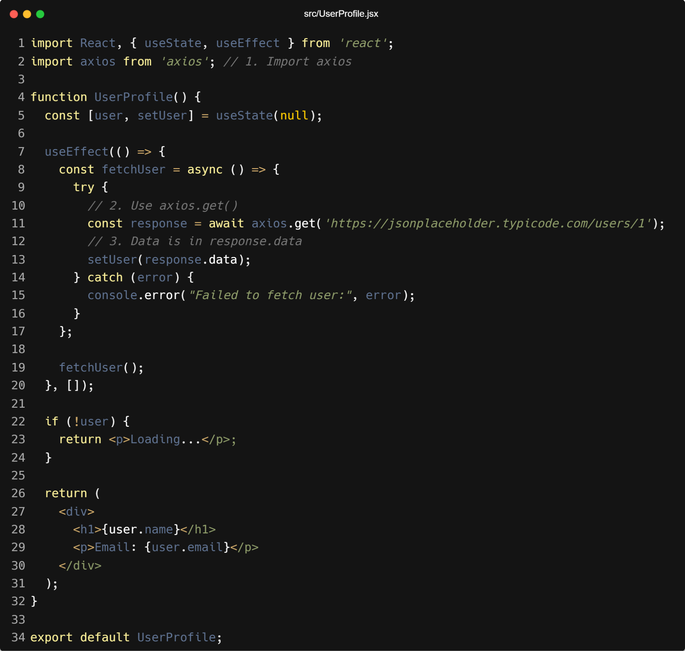
| Coding Questions
Solution :

Slide 34

| Coding Questions
Output :

Slide 35
| Coding Questions
2. Handling Loading and Error States
Task :
Create a component PostFetcher that fetches a post from an API. Implement three states: loading, error, and data.
Initially, display a "Loading post..." message.
If the fetch is successful, display the post's title.
If the fetch fails (e.g., the URL is incorrect), display an error message.

Slide 36
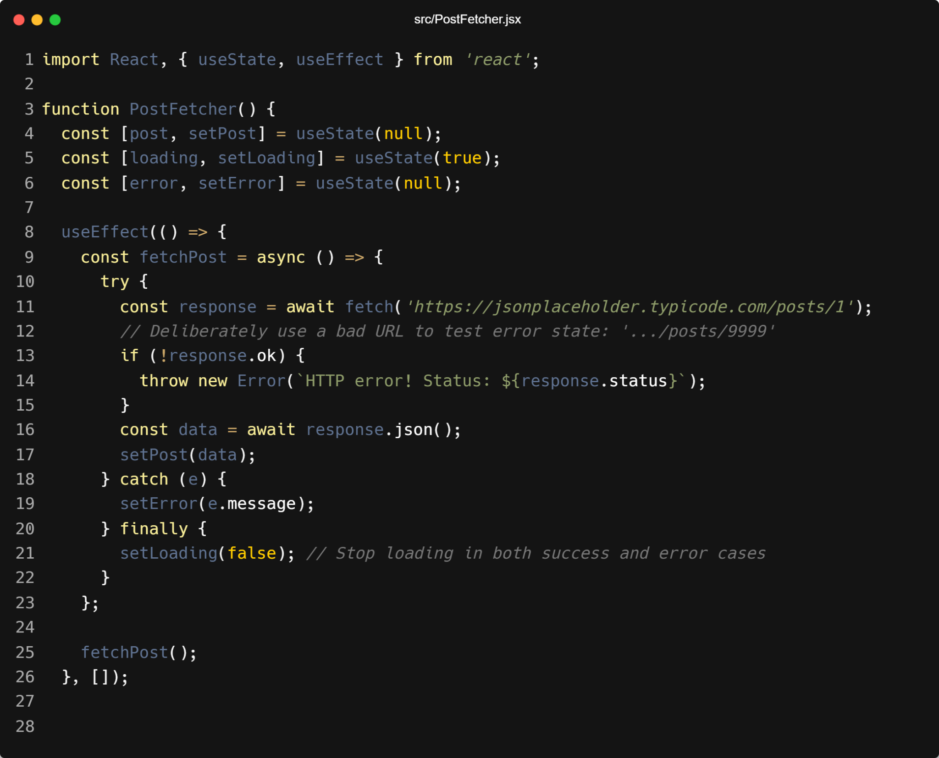
| Coding Questions
Solution :

Slide 37
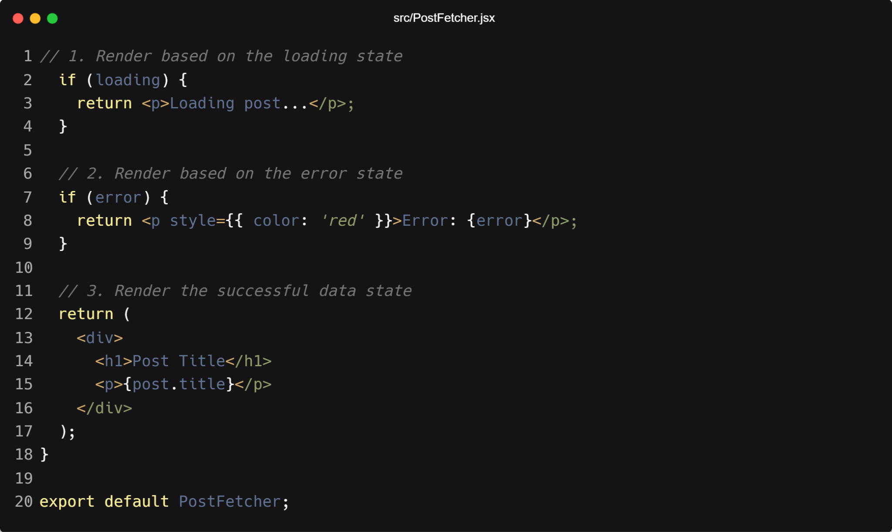
| Coding Questions
Solution :

Slide 38

| Coding Questions
Output :

Slide 39
| Check Your Understanding
Question : What is the most common reason for a React component to have a "loading state"?
Options : a) To make the component load faster.
b) To show the user that a data-fetching operation is in progress and the content is not yet
available.
c) To load CSS styles before the component renders.
d) To check for errors in the code.
Answer : b) To show the user that a data-fetching operation is in progress and
the content is not yet available.
Explanation:
A loading state provides crucial user feedback, preventing the user from thinking the application is frozen while waiting for a network request to complete.

Slide 40
| Check Your Understanding
Question : What is a key difference between the native Fetch API and the Axios library?
Options : a) Only Axios can make POST requests.
b) Axios automatically throws an error on bad HTTP statuses (like 404 or 500), while Fetch does
not.
c) Only Fetch can be used with async/await.
d) Fetch automatically parses JSON data, while Axios does not.
Answer : b) Axios automatically throws an error on bad HTTP statuses (like 404 or
500), while Fetch does not.
Explanation:
With fetch, you have to manually check response.ok. Axios simplifies error handling by rejecting the promise for any 4xx or 5xx status code, which often leads to cleaner catch blocks.

Slide 41
| Check Your Understanding
Question : When implementing a "load more" button for an infinite scroll effect, how should
you update your component's data state?
Options : a) Replace the old data array with the new data array.
b) Create a new array by combining the previous data with the newly fetched data.
c) Push the new data directly into the existing state array.
d) Store each page of data in a separate state variable.
Answer : b) Create a new array by combining the previous data with the newly
fetched data.
Explanation:
To create a continuous list, you must append the new data to the existing data. The correct way to do this in React is to create a new array, typically using the spread syntax: setData(prevData => [...prevData, ...newData]);.

Slide 42
| References
MDN Web Docs : Comprehensive and official documentation for JS. 🔗https://developer.mozilla.org/en-US/docs/Web/JavaScript
W3Schools – JS Tutorial : Beginner-friendly JS tutorials with examples and interactive editors. 🔗 https://www.w3schools.com/js/
react.dev - A comprehensive, tutorial-style website that deeply explores core React concepts, including components, state, effects, and hooks, through interactive examples and in-depth explanations.
🔗https://react.dev/

Slide 43
Thanks
For
Watching
Course - Web Development - II
welcome@krmangalam.edu.in
Sohna Road,Gurugram,Haryana 122103

